Slide 1
Implementasi Struktur Data
Tipe Data Abstrak (Abstract Data Type / ADT) dan ArrayList

Slide 2

Remember this?
Algorithm
A clearly specified set of simple instructions to be followed to solve a problem
What is a good algorithm?
The longest?
The biggest?
The scariest?
The most efficient → running time, memory

Slide 3
Abstract Data Type (ADT)
Data Structure Implementation

Slide 4

ADT - Overview
Computer programs also need to organize their data. Programs can use a list, a stack, a dictionary, and so on. These ways of organizing data are represented by abstract data types.
An abstract data type, or ADT, is a specification that describes a data set and the operations on that data.
Each ADT specifies what data is stored and what the operations on the data do. ADTs independently of any programming language it doesn’t indicate how to store / how to implement!
In contrast, a data structure is an implementation of an ADT within a programming language.
A collection is a general term for an ADT that contains a group of objects.
A container is a class that implements a collection. Some people use the terms “container” and “collection” interchangeably.
Notes:
Demikian pula, seringkali tidak penting bagaimana suatu struktur data dibentuk untuk dapat menggunakannya. Misal, kita semua terbiasa menggunakan array, tapi jika dipikirkan lebih dalam, kita akan merasa bingung: apakah semua indeks yang berurutan pada array juga disimpan berurutan di memori, atau tersimpan saling berjauhan?
Jawabannya?
Hal tersebut tidak penting ☺ Selama array yang kita buat bekerja sebagaimana seharusnya, tak ada masalah bagi kita. Kita hanya perlu dapat mengimplementasikannya.
Tanpa sadar, kita telah sering menggunakan abstraksi (abstraction) dari suatu tipe data

Slide 5
ADT - Overview
ADT, is a specification for a group of values and the operations on those values that is defined conceptually and independently of any programming language.
Imagine a paper bag, a reusable cloth bag, or even a plastic bag.
People use bags when they shop, pack a lunch, or eat potato chips. Bags contain things, but you don’t really care if things order exactly!
Notes:
A bag does not order its contents, but sometimes you do want to order things. ADTs can order
their items in a variety of ways.
ADT list, for example, simply numbers its items. A list, then, has a first item, a second item, and so on,
ADTs stack and queue order their items chronologically,
ADT dictionary contains pairs of items,
ADT tree organizes its entries according to some hierarchy

Slide 6
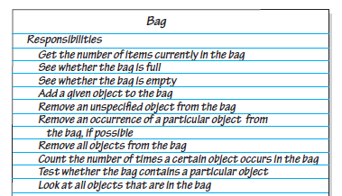
Bag’s Behavior
Bag contains a finite number of objects, reporting how many objects it contains could be one of a bag’s behaviors:
Get the number of items currently in the bag
Two related behaviors detect whether a bag is full or empty:
See whether the bag is full
See whether the bag is empty
We should be able to add and remove objects:
Add a given object to the bag
Remove an unspecified object from the bag
Remove an occurrence of a particular object from the bag, if possible
Remove all objects from the bag

Slide 7
So..?
Abstract data type (ADT) adalah kumpulan objek beserta operasinya. ADT merupakan suatu pemodelan, jadi pada pendifinisiannya tidak dituliskan bagaimana cara implementasi dari operasi ADT.
Ingat perbedaan tipe data (primitive) dengan tipe data objek (reference)?
Tipe data memiliki operasi tersendiri (+, -, * dst), demikian juga ADT memiliki operasi-operasi tersendiri.

Slide 8
Then…
Pembuatan ADT terbagi dua:
Pembuatan interface, yang berisi spesifikasi atau dokumentasi dari ADT.
Implementasi ADT: bagaimana operasi tersebut dilakukan menggunakan struktur data dan perintah yang ada pada bahasa pemrograman tertentu (dalam hal ini, Java)
ADT hanya berisi spesifikasi atau detil dari interface, bukan implementasinya. Pemisahan ini penting, karena user hanya perlu tahu apa saja operasinya, bukan bagaimana cara operasi tersebut dilakukan.

Slide 9
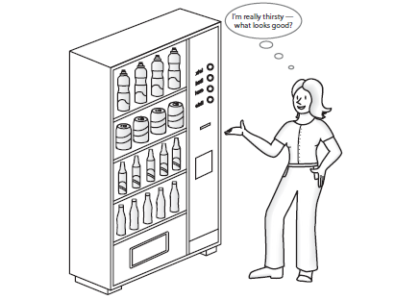
If it’s still confusing…
In general, the steps of building ADT to data structures are:
Understand and clarify the nature of the target information unit.
Identify and determine which data objects and operations to include in the models.
Express this property somewhat formally so that it can be understood and communicate well.
Translate this formal specification into proper language. In Java, this is called "user interface".
Upon finalized specification, write necessary implementation. This includes storage scheme and operational detail. Operational detail is expressed as separate functions (methods).
Using ADT is Like Using Vending Machine!
Notes:
When you look at the front of a vending machine, you see its interface. By inserting coins
and pressing buttons, you are able to make a purchase.
● You can perform only the specific tasks that the machine’s interface presents to you.
● You must understand these tasks—that is, you must know what to do to buy a soda.
You can use the machine even though you do not know what happens inside!

Slide 10
ArrayList
Implementasi Struktur Data

Slide 11
Struktur Data
REMEMBER THIS ?
A data structure is a way of organizing input data and operations which can be performed on this data

Slide 12
JAVA COLLECTION
“A collection — sometimes called a container — is simply an object that groups multiple elements into a single unit. Collections are used to store, retrieve, manipulate, and communicate aggregate data.”
Collection merupakan suatu interface, atau tipe data abstrak (ADT) yang kemudian akan diimplementasikan pada kelas-kelas yang juga disediakan pada framework Java Collection

Slide 13
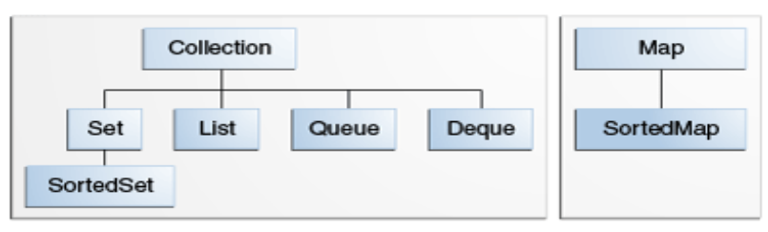
JAVA COLLECTION INTERFACE

Slide 14
ARRAYLIST
Array tidak dapat diubah besarnya secara otomatis pada saat program dijalankan
Pemecahannya? Gunakan ArrayList
Besar dari suatu ArrayList dapat berubah secara dinamis
ArrayList<E> merupakan suatu kelas yang berada pada package java.util
Jangan lupa import package java.util.ArrayList
Tanda “E” pada kelas ArrayList dapat dianggap sebagai suatu “placeholder”

Slide 15
ARRAYLIST
Tanda “E” pada kelas ArrayList dapat dianggap sebagai suatu “placeholder”, yang dapat diisi dengan suatu tipe data tertentu
Dengan demikian, ArrayList dapat memiliki tipe data apapun, yang dinyatakan sebagai kelas generic
Tetapi, hanya tipe data reference yang dapat diisikan pada kelas generic → tipe data primitive tidak bisa

Slide 16
Boxing → wrapped the primitive data type
Primitive Data Type | Wrapper Class
byte | Byte
short | Short
int | Integer
long | Long
Sumber: https://www.w3schools.com/java/java_wrapper_classes.asp

Slide 17
Deklarasi
ArrayList<tipe_data> nama_ArrayList = new ArrayList<>();
Dapat diisi dengan tipe data yang sama, atau dikosongkan untuk bagian Belakang (diamond <> notation)
Tipe data harus berbentuk class (karena array list penyimpanan array of object).
Tipe dapat tidak dituliskan.
Bentuk Umum Pendeklarasian

Slide 18
Methods of ArrayList
Method | Deskripsi
add | Menambah elemen pada akhir atau pada spesifik indeks di ArrayList
clear | Menghapus seluruh elemen dari ArrayList
contains | Mengembalikan nilai true jika ArrayList mengandung nilai elemen tertentu, jika tidak akan mengembalikan false
get | Mengembalikan elemen pada index tertentu
indexOf | Mengembalikan indeks dari kemunculan pertama dari elemen tertentu di ArrayList
remove | Menghapus nilai tertentu pada kemunculan pertama atau pada indeks tertentu
size | Mengembalikan jumlah elemen yang tersimpan pada ArrayList
trimToSize | Memotong kapasitas ArrayList pada jumlah elemen yang ada saat ini.

Slide 19
Reference
Carrano, Frank., Data Structure and Abstraction, Prentice Hall
Weiss ,M. A., Data Structures and Algorithm Analysis in Java 3rd Ed, Pearson Education Inc.
Adams, B. G., Introduction To Computer Science: An Object-oriented Approach Using Java 5, BlueJ and BeanShell Edition.

Slide 20
Reference
Java11 SE Docs, ”Introduction to Collection”, https://docs.oracle.com/javase/tutorial/collections/intro/index.html
Deitel P., Deitel H., Java How to Program, Early Objects (Deitel: How to Program),
11th Edition, Pearson (2017)

